Slide 1

Project Procurement Management BAI3020
Information Technology Project Management, Sixth Edition

Slide 2
Importance of Project Procurement Management
Procurement means acquiring goods and/or services from an outside source
Other terms include purchasing and outsourcing
People continue to debate whether offshore outsourcing helps their own country or not

Slide 3
IT Outsourcing Survey Results
The IT function with the largest percentage of work outsourced is disaster recovery services, accounting for 50 percent of total IT outsourcing
Even though application development and maintenance are frequently outsourced, they are a low percentage of the amount of total IT work outsourced

Slide 4
Why Outsource?
To reduce both fixed and recurrent costs
To allow the client organization to focus on its core business
To access skills and technologies
To provide flexibility
To increase accountability

Slide 5
Contracts
A contract is a mutually binding agreement that obligates the seller to provide the specified products or services and obligates the buyer to pay for them
Contracts can clarify responsibilities and sharpen focus on key deliverables of a project
Because contracts are legally binding, there is more accountability for delivering the work as stated in the contract

Slide 6
What Went Wrong?
Companies often change their minds about procurement; for example, JPMorgan Chase announced a seven-year, $5 billion deal to outsource much of its data processing to IBM, but they revoked the contract less than two years into its existence because the procurement plan no longer fit their business strategy (is that breach of contract?)
The Australian Computer Society says sending work offshore may lower the number of students entering IT courses, deplete the number of skilled IT professionals, and diminish the nation’s strategic technology capability – (President Obama calls for more skilled education)
Procurement can also cause security problems, including the protection of intellectual property, integrity of data, and the reliability of infrastructure in offshore locations

Slide 7
Project Procurement Management Processes
Project procurement management: acquiring goods and services for a project from outside the performing organization
Processes include:
Planning procurements: determining what to procure, when, and how
Conducting procurements: obtaining seller responses, selecting sellers, and awarding contracts
Administering procurements: managing relationships with sellers, monitoring contract performance, and making changes as needed
Closing procurements: completing and settling each contract, including resolving of any open items

Slide 8
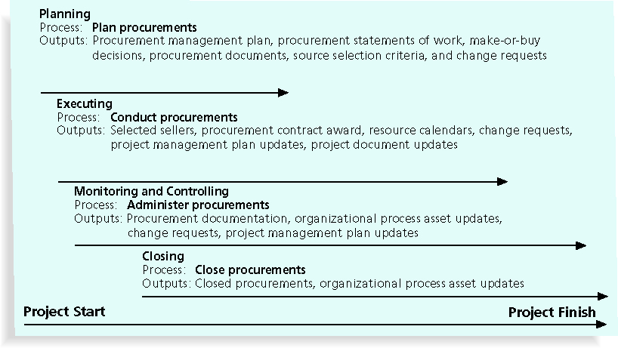
Project Procurement Management Summary

Slide 9
Planning Procurements
Identifying which project needs can best be met by using products or services outside the organization
Is there a need to Procure?

Slide 10
What Went Right?
Several organizations, such as The Boots Company PLC in England, outsource their IT services to save money compared with the cost of running the systems themselves
Carefully planning procurement can also save millions of dollars, as the U.S. Air Force did by using a unit pricing strategy for a large office automation project

Slide 11
Tools and Techniques for Planning Purchases and Acquisitions
Make-or-buy analysis:
Availability of resources and skills
Direct control/customization required
Availability of the product
Reliability of the suppliers
Small volume requirements
Limited capacity
Competition
Degree of standardization
Maintenance, support and service required
Often involves financial analysis
Experts, both internal and external, can provide valuable inputs in procurement decisions

Slide 12
Make-or-Buy Example
Assume you can lease an item you need for a project for $800/day for 20 working days
to purchase the item, the cost is $12,000 plus a daily operational cost of $400/day
Which model should you choose

Slide 13
Make-or Buy Solution
$800/day for 20 working days = $16,000
$12,000 purchase price + $400x20 working days = $20,000
So naturally it makes sense to lease for the duration of the project

Slide 14
Types of Contracts
Fixed price or lump sum contracts:
fixed total price for a well-defined product or service
Cost reimbursable contracts:
payment to the seller for direct and indirect costs
Time and material contracts:
hybrid of both fixed price and cost reimbursable contracts, often used by consultants
Unit price contracts: requires the buyer to pay the seller a predetermined amount per unit of service (maybe per deliverable?)

Slide 15
Fixed Price Contracts
Firm-Fixed Price (FFP)
Fixed Price Incentive Fee (FPIF)
Fixed Price with Economic Price
Adjustment (FP-EPA) – inflation, price increase for commodities

Slide 16
Cost Reimbursable Contracts
Cost plus incentive fee (CPIF):
performance costs plus a predetermined fee and an incentive bonus which is measurable – say meeting targets..)
Cost plus fixed fee (CPFF):
performance costs plus a fixed fee payment usually based on a percentage of estimated costs

Slide 17
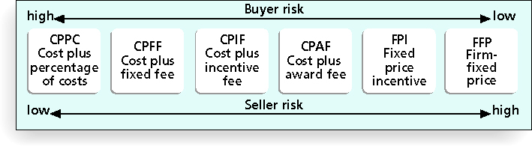
Contract Types versus Risk

Slide 18
Media Snapshot
Contract incentives can be extremely effective; on August 1, 2007, tragedy struck Minneapolis, Minnesota, when a bridge on I-35W collapsed, killing 13 motorists, injuring 150 people, and leaving a mass of concrete and steel in the river and on its banks
Peter Sanderson, project manager for the joint venture of Flatiron-Manson led his team in completing the project; the contractors earned $25 million in incentive fees on top of their $234 million contract for completing the bridge three months ahead of schedule
MnDOT justified the incentive payment by saying that each day the bridge was closed, it cost road users more than $400,000

Slide 19
Assignment
From your experiences; in teams provide some real-life examples of where you have seen collusion between Buyer and seller, Buyer alone and seller alone in procurement.

Slide 20
Procurement Management Plan
Describes how the procurement processes will be managed, from developing documentation for making outside purchases or acquisitions to contract closure
Contents vary based on project needs

Slide 21
Contract Statement of Work (SOW)
A statement of work is a description of the work required for the procurement
contract statement of work is for contracts alone
A SOW is a specific scope statement
A good SOW gives bidders a better understanding of the buyer’s expectations

Slide 22
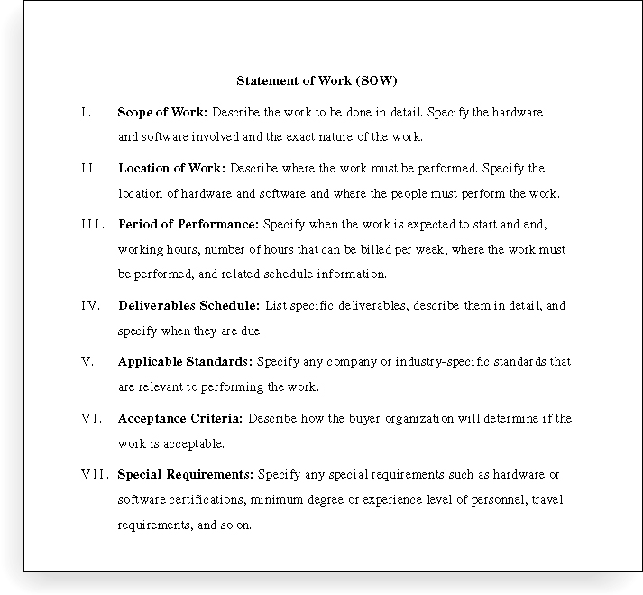
Statement of Work (SOW) Template

Slide 23
Procurement Documents
Request for Proposals: used to solicit proposals from prospective sellers
A proposal is a document prepared by a seller when there are different approaches for meeting buyer needs
Requests for Quotes: used to solicit quotes or bids from prospective suppliers
A bid, also called a tender or quote (short for quotation), is a document prepared by sellers providing pricing for standard items that have been clearly defined by the buyer

Slide 24
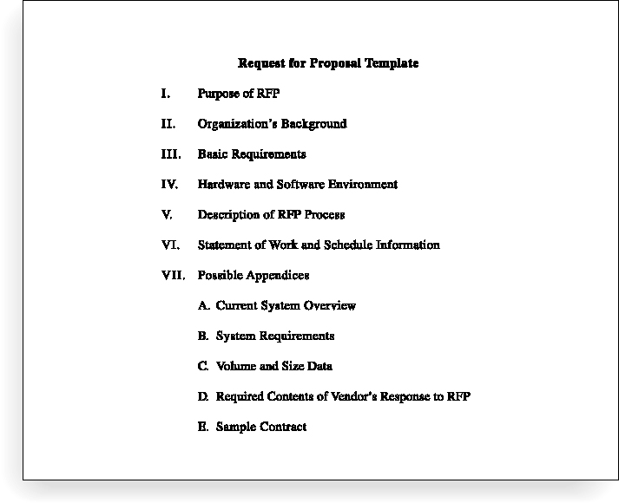
Request for Proposal (RFP) Template

Slide 25
Evaluation Criteria
It’s important to prepare some form of evaluation criteria, preferably before issuing a formal RFP or RFQ
Can require a technical presentation as part of a proposal

Slide 26
Conducting Procurements
Deciding whom to ask to do the work
Sending appropriate documentation to potential sellers
Obtaining proposals or bids
Selecting a seller
Awarding a contract

Slide 27
Approaches for Procurement
Organizations can advertise to procure goods and services in several ways:
Approaching the preferred vendor
Approaching several potential vendors
Advertising to anyone interested
A bidders’ conference can help clarify the buyer’s expectations

Slide 28
Source Selection
Evaluating proposals or bids from sellers
Choosing the best one
Negotiating the contract
Awarding the contract

Slide 29
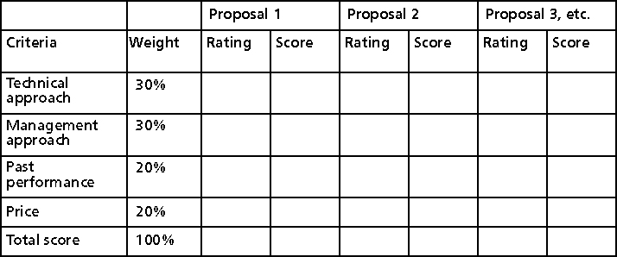
Sample Proposal Evaluation Sheet

Slide 30
Seller Selection
Organizations often do an initial evaluation of all proposals and bids and then develop a short list of potential sellers for further evaluation
Sellers on the short list often prepare a best and final offer (BAFO)
Final output is a contract signed by the buyer and the selected seller

Slide 31
Administering Procurements
Ensures seller’s performance meets contractual obligations
Legal to create contracts
It is critical that project managers and team members watch for constructive change orders, which are oral or written acts or omissions by someone with actual or apparent authority that can be construed to have the same effect as a written change order

Slide 32
Suggestions for Change Control in Contracts
Changes to any part of the project need to be reviewed, approved, and documented by the same people in the same way that the original part of the plan was approved
Evaluation of any change should include an impact analysis; how will the change affect the scope, time, cost, and quality of the goods or services being provided?
Changes must be documented in writing; project team members should also document all important meetings and telephone phone calls

Slide 33
Suggestions for Change Control in Contracts (continued)
Project managers and teams should stay closely involved to make sure the new system will meet business needs and work in an operational environment
Have backup plans
Use tools and techniques, such as a contract change control system, buyer-conducted performance reviews, inspections and audits, and so on

Slide 34
Best Practice
Accenture developed a list of best practices from experienced outsourcers throughout the world:
Build in Broad Business Outcomes Early and Often
Hire a Partner, Not Just a Provider
It’s More Than a Contract, It’s a Business Relationship
Leverage Gain-Sharing
Use Active Governance
Assign a Dedicated Executive
Focus Relentlessly on Primary Objectives

Slide 35
Closing Procurements
Involves completing and settling contracts and resolving any open items
The project team should:
Ensure all work was completed – sign off
Update records
Archive

Slide 36
Chapter Summary
Project procurement management involves acquiring goods and services for a project from outside the performing organization
Processes include:
Plan procurements
Conduct procurements
Administer procurements
Close procurements

